Slide 1
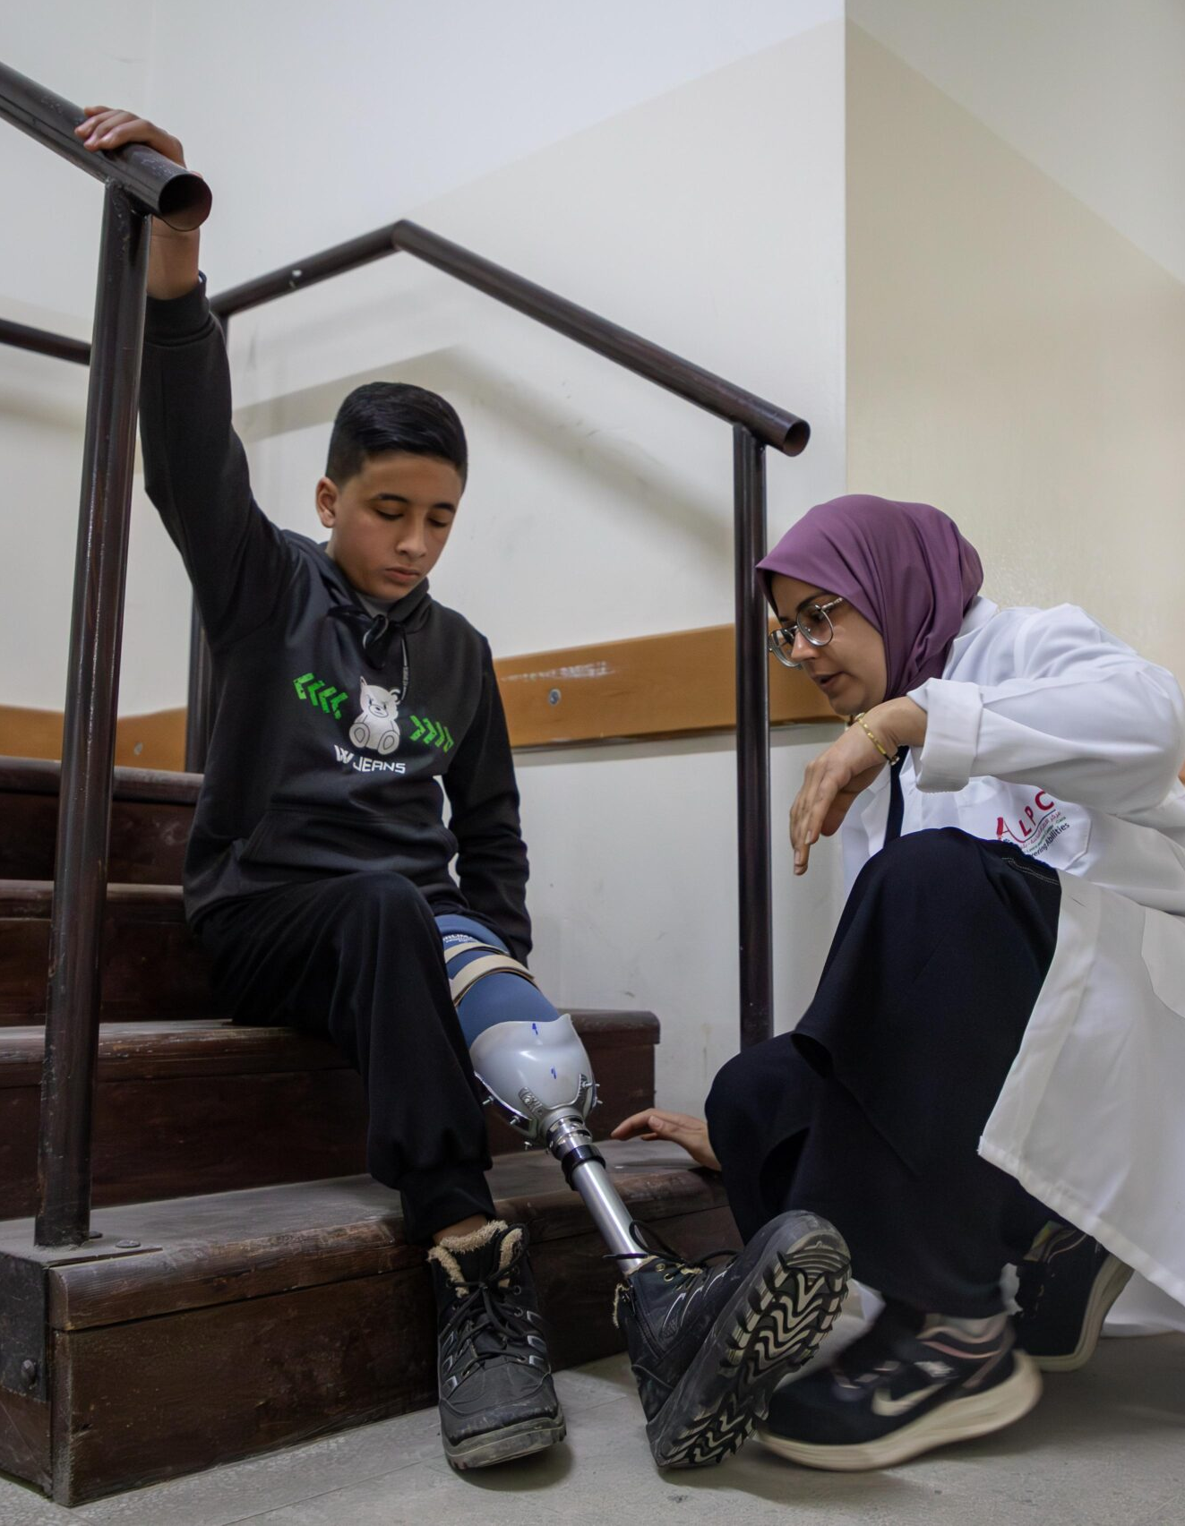
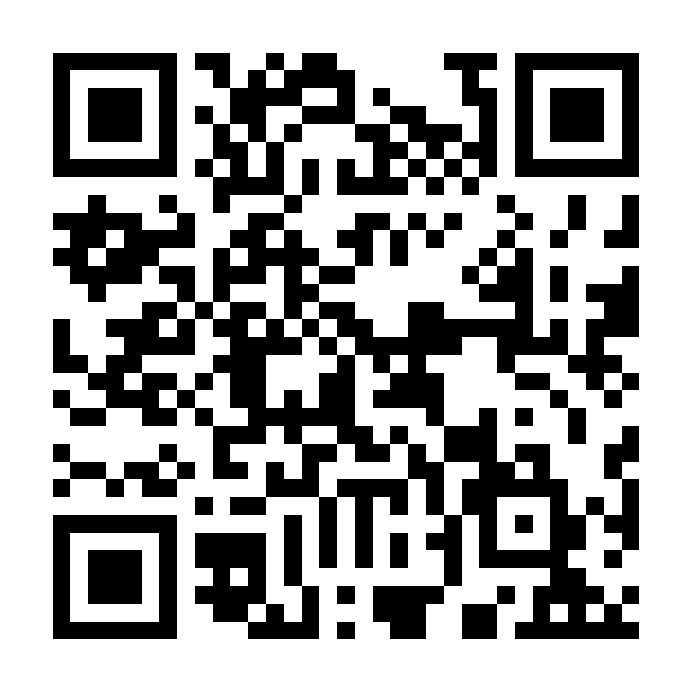
GAZA CRISIS APPEAL
Over 4,500 people have been made amputees due to the current conflict.
Your support can help provide prosthetic limbs and rehabilitation.
DONATE NOW
www.caritas.org.au/gaza
1800 024 413
Photo: Caritas Jerusalem

